Slide 1
Linear Regression (Contd), Linear Classification
CS771: Introduction to Machine Learning
Piyush Rai

Slide 2

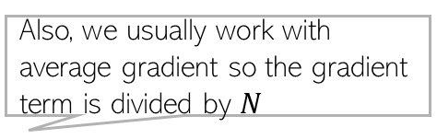
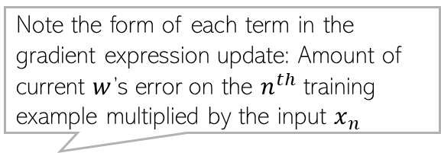
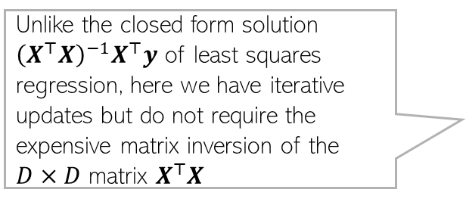
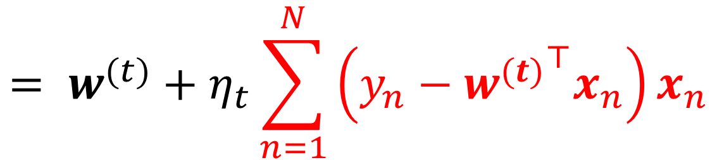
Gradient Descent for Linear/Ridge Regression
Just use the GD algorithm with the gradient expressions we derived
Iterative updates for linear regression will be of the form
Similar updates for ridge regression as well (with the gradient expression being slightly different; left as an exercise)
More on iterative optimization methods later
Also, we usually work with average gradient so the gradient term is divided by $N$
$$w^{(t+1)}= w^{(t)}−η_{t}g^{\left(t\right)}$$
Note the form of each term in the gradient expression update: Amount of current $w$’s error on the $n^{th}$ training example multiplied by the input $x_{n}$
Unlike the closed form solution ${\left(X^{⊤}X\right)}^{−1}X^{⊤}y$ of least squares regression, here we have iterative updates but do not require the expensive matrix inversion of the $D×D$ matrix $X^{⊤}X$
$$= w^{(t)}+η_{t}\sum_{n=1}^{N}{\left(y_{n}−{w^{(t)}}^{⊤}x_{n}\right)x_{n}}$$

Slide 3



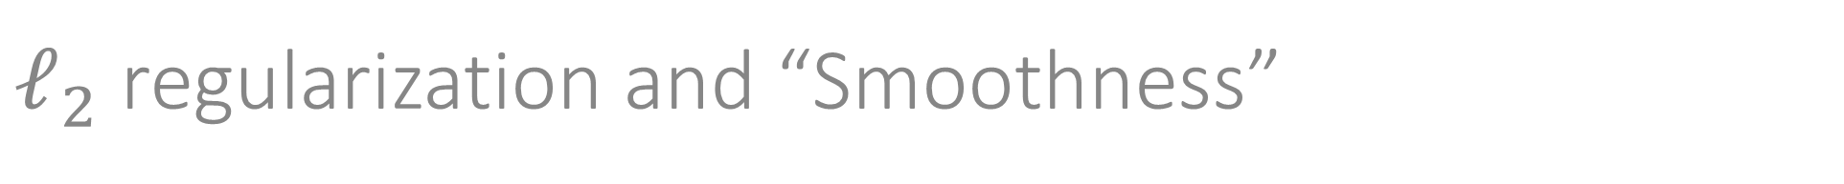

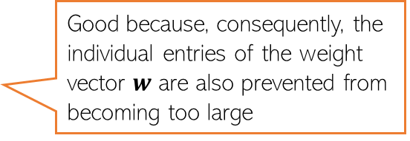

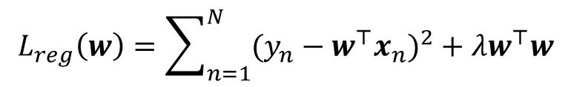



$ℓ_{2}$ regularization and “Smoothness”
Remember – in general, weights with large magnitude are bad since they can cause overfitting on training data and may not work well on test data
The regularized objective we minimized is
Minimizing $L_{reg}\left(w\right)$w.r.t. $w$ gives a solution for $w$ that
Keeps the training error small
Has a small $ℓ_{2}$ squared norm $w^{⊤}w$ = $\sum_{d=1}^{D}{w_{d}^{2}}$
Small entries in $w$ are good since they lead to “smooth” models
$$L_{reg}\left(w\right)=\sum_{n=1}^{N}{{(y_{n}−w^{⊤}x_{n})}^{2}}+λw^{⊤}w$$
Good because, consequently, the individual entries of the weight vector $w$ are also prevented from becoming too large
Not a “smooth” model since its test data predictions may change drastically even with small changes in some feature’s value
A typical $w$ learned without $ℓ_{2}$ reg.
$$x_{n}=$$
1.2
0.5
2.4
0.3
0.8
0.1
0.9
2.1
$$y_{n}=0.8$$
3.2
1.8
1.3
2.1
10000
2.5
3.1
0.1
$$x_{m}=$$
$$y_{m}=100$$
1.2
0.5
2.4
0.3
0.8 $+ ε$
0.1
0.9
2.1
Just to fit the training data where one of the inputs was possibly an outlier, this weight became too big. Such a weight vector will possibly do poorly on normal test inputs
Exact same feature vectors only differing in just one feature by a small amount
Very different outputs though (maybe one of these two training ex. is an outlier)

Slide 4


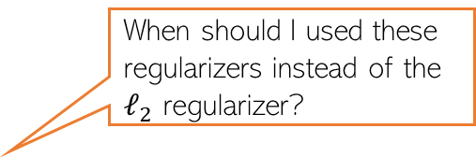
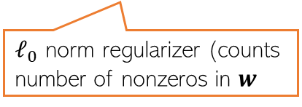



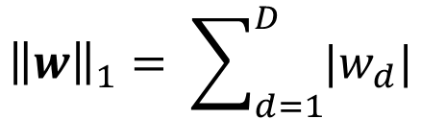

Other Ways to Control Overfitting
Note that optimizing loss functions with such regularizers is usually harder than ridge reg. but several advanced techniques exist (we will see some of those later)
Use a regularizer $R\left(w\right)$ defined by other norms, e.g.,
Use non-regularization based approaches
Early-stopping (stopping training just when we have a decent val. set accuracy)
Dropout (in each iteration, don’t update some of the weights)
Injecting noise in the inputs
$ℓ_{1}$ norm regularizer
Use them if you have a very large number of features but many irrelevant features. These regularizers can help in automatic feature selection
$${\left\|w\right\|}_{1}= \sum_{d=1}^{D}{|w_{d}|}$$
When should I used these regularizers instead of the $ℓ_{2}$ regularizer?
$${\left\|w\right\|}_{0}=\#nnz(w)$$
Using such regularizers gives a sparse weight vector $w$ as solution (will see the reason in detail later)
sparse means many entries in $w$ will be zero or near zero. Thus those features will be considered irrelevant by the model and will not influence prediction
Automatic feature selection? Wow, cool!!!
But how exactly?
$ℓ_{0}$ norm regularizer (counts number of nonzeros in $w$
All of these are very popular ways to control overfitting in deep learning models. More on these later when we talk about deep learning

Slide 5
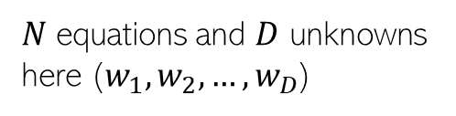
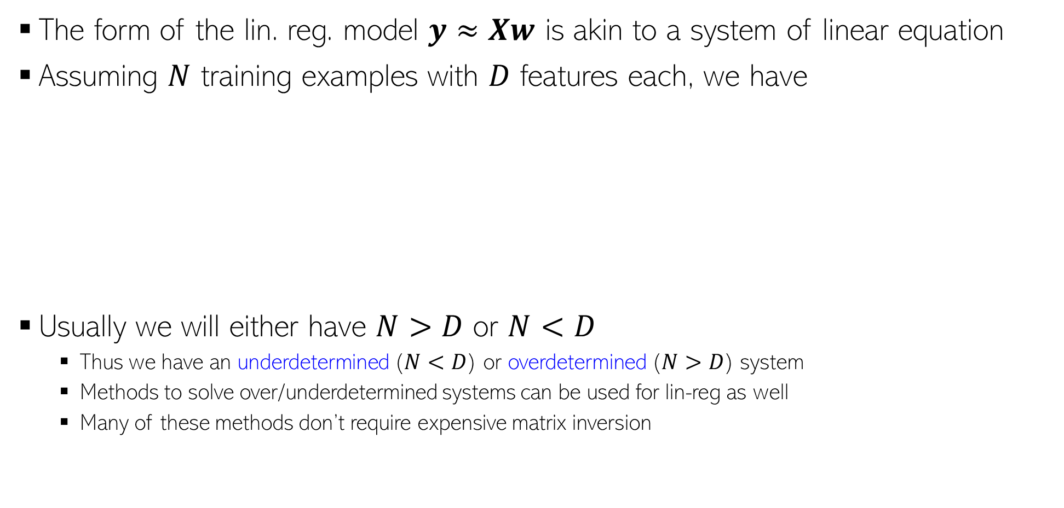
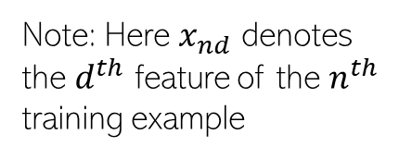

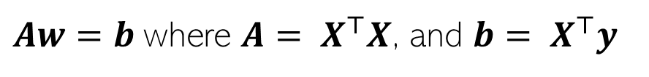


Linear Regression as Solving System of Linear Eqs
The form of the lin. reg. model $y≈Xw$ is akin to a system of linear equation
Assuming $N$ training examples with $D$ features each, we have
Usually we will either have $N>D$ or $N<D$
Thus we have an underdetermined ($N<D$) or overdetermined ($N>D$) system
Methods to solve over/underdetermined systems can be used for lin-reg as well
Many of these methods don’t require expensive matrix inversion
First training example:
$$y_{1}=x_{11}w_{1}+x_{12}w_{2}+ …+x_{1D}w_{D}$$
Note: Here $x_{nd}$ denotes the $d^{th}$ feature of the $n^{th}$ training example
Second training example:
$$y_{2}=x_{21}w_{1}+x_{22}w_{2}+ …+x_{2D}w_{D}$$
$N$ equations and $D$ unknowns here ($w_{1},w_{2},…,w_{D}$)
N-th training example:
$$y_{N}=x_{N1}w_{1}+x_{N2}w_{2}+ …+x_{ND}w_{D}$$
Now solve this!
Solving lin-reg
as system of lin eq.
$$w{=(X^{⊤}X)}^{−1}X^{⊤}y$$
$Aw=b$ where ${A= X}^{⊤}X$, and ${b= X}^{⊤}y$
System of lin. Eqns with $D$ equations and $D$ unknowns

Slide 6
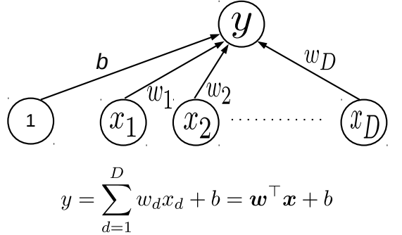


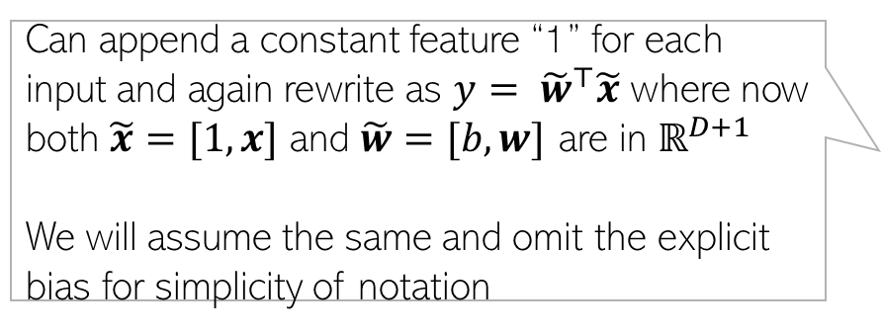



The bias term
6
Linear models usually also have a bias term $b$ in addition to the weights
Can append a constant feature “1” for each input and again rewrite as $y= {\tilde{w}}^{⊤}\tilde{x}$ where now both $\tilde{x}=[1, x]$ and $\tilde{w}=[b,w]$ are in $ℝ^{D+1}$
We will assume the same and omit the explicit bias for simplicity of notation
$$D$$
$$D+1$$
X
1
1
1
1
1
.
.
.
.
1
1
1
X
$$N$$
$$N$$

Slide 7
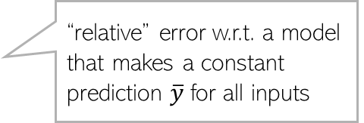


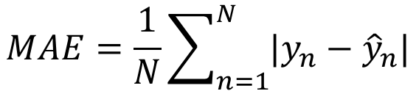
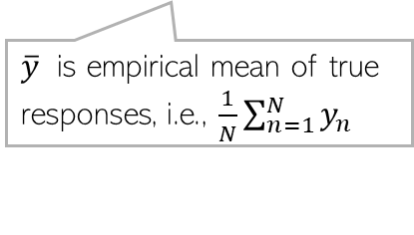
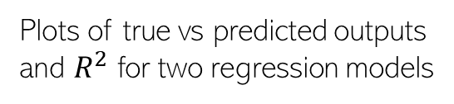
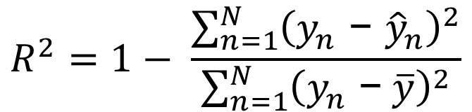
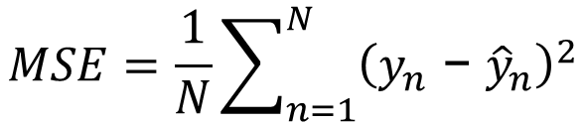
Evaluation Measures for Regression Models
Prediction
Plotting the prediction ${\hat{y}}_{n}$ vs truth $y_{n}$ for the validation/test set
Mean Squared Error (MSE) and Mean Absolute Error (MAE) on val./test set
RMSE (Root Mean Squared Error) $≜\sqrt{MSE }$
Coefficient of determination or $R^{2}$
Truth
$$MSE=\frac{1}{N}\sum_{n=1}^{N}{{\left(y_{n}\text{ − }{\hat{y}}_{n}\right)}^{2}}$$
$$MAE=\frac{1}{N}\sum_{n=1}^{N}{|y_{n}−{\hat{y}}_{n}|}$$
Plots of true vs predicted outputs
and $R^{2}$ for two regression models
$$R^{2}=1− \frac{\sum_{n=1}^{N}{{\left(y_{n}\text{ − }{\hat{y}}_{n}\right)}^{2}}}{\sum_{n=1}^{N}{{\left(y_{n}\text{ −} \overline{y}\right)}^{2}}}$$
“relative” error w.r.t. a model that makes a constant prediction $\overline{y}$for all inputs
A “base” model that always predicts the mean $\overline{y}$ will have $R^{2}=0$ and the perfect model will have $R^{2}=1$. Worse than base models can even have negative $R^{2}$
$\overline{y}$ is empirical mean of true responses, i.e., $\frac{1}{N}\sum_{n=1}^{N}{y_{n}}$
Pic from MLAPP (Murphy)

Slide 8
Linear Models for Classification
8

Slide 9



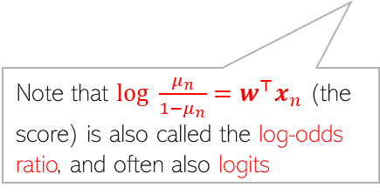

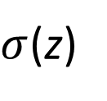



Linear Models for Classification
9
A linear model $y= w^{⊤}x$ can also be used in classification
For binary classification, can treat $w^{⊤}x_{n}$ as the “score” of input $x_{n}$ and either
Threshold the score to get a binary label
Convert the score into a probability
Note: In LR, if we assume the label $y_{n}$ as -1/+1 (not 0/1) then we can write
Large positive score means positive label, otherwise negative label
Note that $log \frac{μ_{n}}{1−μ_{n}}=w^{⊤}x_{n}$ (the score) is also called the log-odds ratio, and often also logits
$$y_{n}= sign(w^{⊤}x_{n})$$
1
$$μ_{n}= p\left(y=1 | x_{n},w\right)=σ\left(w^{⊤}x_{n}\right)$$
The “sigmoid” function
$σ$(z)
$$=\frac{1}{1+exp(−w^{⊤}x_{n})}$$
Squashes a real number to the range 0-1
Popularly known as “logistic regression” (LR) model (misnomer: it is not a regression model but a classification model), a probabilistic model for binary classification
0.5
$$=\frac{exp(w^{⊤}x_{n})}{1+exp(w^{⊤}x_{n})}$$
0
$$\text{z}$$
$$p\left(y_{n} | w,x_{n}\right)=\frac{1}{1+exp(−y_{n}w^{⊤}x_{n})}=σ(y_{n}w^{⊤}x_{n})$$

Slide 10


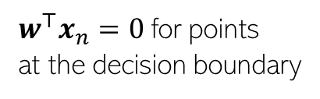




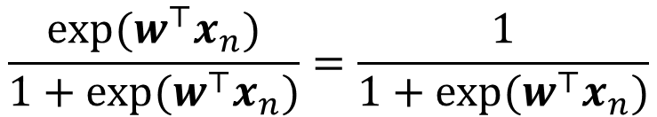


Linear Models: The Decision Boundary
Decision boundary is where the score $w^{⊤}x_{n}$ changes its sign
Decision boundary is where both classes have equal probability for the input $x_{n}$
For logistic reg, at decision boundary
$$w$$
$$p\left(y_{n}=1 | w,x_{n}\right)=p(y_{n}=0|w,x_{n})$$
$$w^{⊤}x_{n}>0$$
$$\frac{exp(w^{⊤}x_{n})}{1+exp(w^{⊤}x_{n})}=\frac{1}{1+exp(w^{⊤}x_{n})}$$
$$w^{⊤}x_{n}<0$$
$$exp\left(w^{⊤}x_{n}\right)=1$$
$w^{⊤}x_{n}=0$ for points
at the decision boundary
$$w^{⊤}x_{n}=0$$
Therefore, both views are equivalent

Slide 11
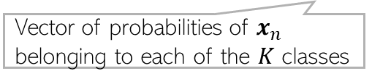
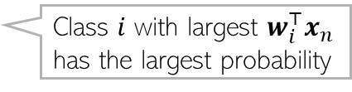



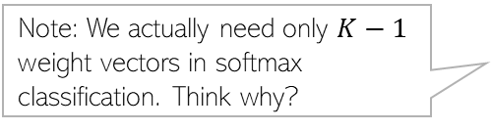
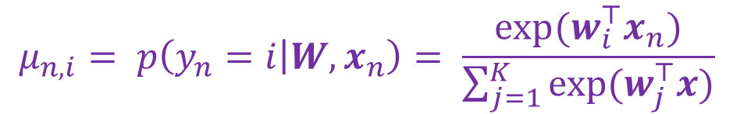


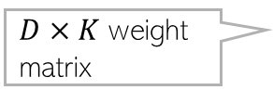
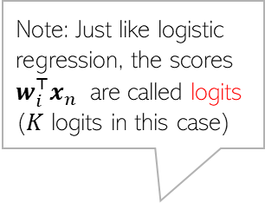

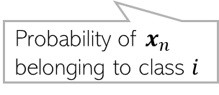
Linear Models for (Multi-class) Classification
If there are $K>2$ classes, we use $K$ weight vectors ${\left\{w_{i}\right\}}_{i=1}^{K}$ to define the model
The prediction rule is as follows
Can think of $w_{i}^{⊤}x_{n}$ as the score/similarity of the input w.r.t. the $i^{th}$ class
Can also use these scores to compute probability of belonging to each class
$D×K$ weight matrix
$$W=[w_{1},w_{2},…, w_{K}]$$
$$y_{n}= {argmax}_{i∈\{1,2,…,K\}} w_{i}^{⊤}x_{n}$$
“softmax” classification
Note: Just like logistic regression, the scores $w_{i}^{⊤}x_{n}$ are called logits ($K$ logits in this case)
$$μ_{n,i}= p\left(y_{n}=i | W,x_{n}\right)= \frac{exp(w_{i}^{⊤}x_{n})}{\sum_{j=1}^{K}{exp(w_{j}^{⊤}x)}}$$
$$μ_{n,i}$$
Multi-class extension of logistic regression
Probability of $x_{n}$ belonging to class $i$
$$i=1$$
$$i=2$$
$$i=3$$
$$\sum_{i=1}^{K}{μ_{n,i}}=1$$
$$μ_{n}=[μ_{n,1}, μ_{n,2},…, μ_{n,K}]$$
Note: We actually need only $K−1$ weight vectors in softmax classification. Think why?
Vector of probabilities of $x_{n}$ belonging to each of the $K$ classes
Class $i$ with largest $w_{i}^{⊤}x_{n}$ has the largest probability
Probabilities must sum to 1

Slide 12

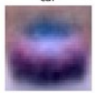
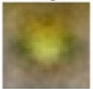
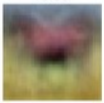
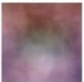






Linear Classification: Interpreting weight vectors
12
Recall that multi-class classification prediction rule is
Can think of $w_{i}^{⊤}x_{n}$ as the score of the input for the $i^{th}$ class (or similarity of $x_{n}$ with $w_{i}$)
Once learned (we will see the methods later), these $K$ weight vectors (one for each class) can sometimes have nice interpretations, especially when the inputs are images
$$y_{n}= {argmax}_{i∈\{1,2,…,K\}} w_{i}^{⊤}x_{n}$$
The learned weight vectors of each of the 4 classes “unflattened” and visualized as images – they kind of look like a “average” of what the images from that class should look like
These images sort of look like class prototypes if I were using LwP ☺
$$w_{car}$$
$$w_{frog}$$
$$w_{horse}$$
$$w_{cat}$$
Yeah, “sort of”. ☺
No wonder why LwP (with Euclidean distances) acts like a linear model. ☺
That’s why the dot product of each of these weight vectors with an image from the correct class will be expected to be the largest

Slide 13


Loss Functions for Classification
13
Assume true label to be $y_{n}∈\{0,1\}$ and the score of a linear model to be $w^{⊤}x_{n}$
One possibility is to use squared loss just like we used in regression
Will be easy to optimize (same solution as the regression case)
Can also consider other loss functions used in regression
Basically, pretend that the binary label is actually a continuous value and treat the problem as regression where the output can only be one of two possible values
However, regression loss functions aren’t ideal since $y_{n}$ is discrete (binary/categorical)
Using the score $w^{⊤}x_{n}$ or the probability $μ_{n}=σ(w^{⊤}x_{n})$ of belonging to the positive class, we have specialized loss function for binary classification
$$l\left(y_{n},w^{⊤}x_{n}\right)={\left(y_{n}−w^{⊤}x_{n}\right)}^{2}$$

Slide 14








Loss Functions for Classification: Cross-Entropy
14
Cross-entropy (CE) is a popular loss function for binary classification. Used in logistic reg.
Assuming true $y_{n}∈\{0,1\}$ and $μ_{n}=σ\left(w^{⊤}x_{n}\right)$ as predicted prob of $y_{n}=1$, CE loss is
For multi-class classification, the CE loss is defined as
$$L\left(w\right)=−\left[\sum_{n=1}^{N}{y_{n} log μ_{n}+\left(1−y_{n}\right)log(1−μ_{n}) }\right]$$
Very large loss if $y_{n}$ is 1and $μ_{n}$ close to 0, or $y_{n}$ is 0and $μ_{n}$ close to 1
This is precisely what we want from a good loss function for binary classification
Note: Sometimes we divide the loss function (not just CE but others too like squared loss) by the number of training examples $N$(doesn’t make a difference to the solution; just a scaling factor. All relevant quantities, such as gradients will also get divided by $N$
$$L\left(W\right)=−\sum_{n=1}^{N}{\sum_{i=1}^{K}{y_{n,i}}log μ_{n,i} }$$
CE loss is also convex in $w$ (can prove easily using definition of convexity; will see later). Therefore unique solution is obtained when we minimize it
$y_{n,i}=1$ if true label of $x_{n}$ is class $i$ and 0 otherwise. $μ_{n,i}$ is the predicted probability of $x_{n}$ belonging to class $i$

Slide 15








Cross-Entropy Loss: The Gradient
15
The expression for the gradient of binary cross-entropy loss
The expression for the gradient of multi-class cross-entropy loss
Note the $μ_{n}$ is a function of $w$
$$g=∇_{w} L\left(w\right)=−\sum_{n=1}^{N}{{(y}_{n} − μ_{n})}x_{n}$$
Using this, we can now do gradient descent to learn the optimal $w$ for logistic regression:
$$w^{(t+1)}= w^{(t)}−η_{t}g^{\left(t\right)}$$
Note the form of each term in the gradient expression: Amount of current $w$’s error in predicting the label of the $n^{th}$ training example multiplied by the input $x_{n}$
Need to calculate the gradient for each of the $K$ weight vectors
$$g_{i}=∇_{w_{i}} L\left(W\right)=−\sum_{n=1}^{N}{(y_{n,i}− μ_{n,i})}x_{n}$$
Using these gradients, we can now do gradient descent to learn the optimal $W=[w_{1},w_{2},…, w_{K}]$
For the softmax classification model
Note the form of each term in the gradient expression: Amount of current $W$’s error in predicting the label of the $n^{th}$ training example multiplied by the input $x_{n}$

Slide 16

Linear Models for Classification
16
A linear model $y= w^{⊤}x$ can also be used in classification
For binary classification, can treat $w^{⊤}x_{n}$ as the “score” of input $x_{n}$ and either
Threshold the score to get a binary label
Convert the score into a probability
Note: In LR, if we assume the label $y_{n}$ as -1/+1 (not 0/1) then we can write
Large positive score means positive label, otherwise negative label
Note that $log \frac{μ_{n}}{1−μ_{n}}=w^{⊤}x_{n}$ (the score) is also called the log-odds ratio, and often also logit
$$y_{n}= sign(w^{⊤}x_{n})$$
1
$$μ_{n}= p\left(y=1 | x_{n},w\right)=σ\left(w^{⊤}x_{n}\right)$$
The “sigmoid” function
$σ$(z)
$$=\frac{1}{1+exp(−w^{⊤}x_{n})}$$
Squashes a real number to the range 0-1
Popularly known as “logistic regression” (LR) model (misnomer: it is not a regression model but a classification model), a probabilistic model for binary classification
0.5
$$=\frac{exp(w^{⊤}x_{n})}{1+exp(w^{⊤}x_{n})}$$
0
$$\text{z}$$
$$p\left(y_{n} | w,x_{n}\right)=\frac{1}{1+exp(−y_{n}w^{⊤}x_{n})}=σ(y_{n}w^{⊤}x_{n})$$

Slide 17








Some Other Loss Functions for Binary Classification
Assume true label as $y_{n}$ and prediction as ${\hat{y}}_{n}=sign[w^{⊤}x_{n}]$
The zero-one loss is the most natural loss function for classification
Since zero-one loss is hard to minimize, we use some surrogate loss function
Popular examples: Cross-entropy (same as logistic loss), hinge loss , etc
Note: Ideally, surrogate loss (approximation of zero-one) must be an upper bound (must be larger than the 0-1 loss for all values of ${y_{n}w}^{⊤}x_{n}$) since our goal is minimization
$$ℓ(y_{n}, {\hat{y}}_{n})=\left\{\begin{aligned}1 \\ 0\end{aligned}\right.$$
if $y_{n}≠{\hat{y}}_{n}$
Non-convex, non-differentiable, and NP-Hard to optimize (also no useful gradient info for the most part)
if $y_{n}={\hat{y}}_{n}$
$$ℓ(y_{n}, {\hat{y}}_{n})=\left\{\begin{aligned}1 \\ 0\end{aligned}\right.$$
if ${y_{n}w}^{⊤}x_{n}<0$
(0,1)
if ${y_{n}w}^{⊤}x_{n}≥0$
(0,0)
$${y_{n}w}^{⊤}x_{n}$$

Slide 18

Some Other Loss Func for Binary Classification
“Perceptron” Loss
For an ideal loss function, assuming $y_{n}∈(−1,+1)$
Large positive ${y_{n}w}^{⊤}x_{n}$⇒ small/zero loss
Large negative ${y_{n}w}^{⊤}x_{n}$⇒ large/non-zero loss
Small (large) loss if predicted probability of the
the true label is large (small)
Also, not an upper bound on 0-1 loss
Convex and Non-differentiable
(0,0)
Same as cross-entropy loss (logistic reg.) if we assume labels to be -1/+1 instead of 0/1
Log(istic) Loss
Hinge Loss
Very popular like cross-entropy loss. Used in SVM (Support Vector Machine) classification
Also an upper bound on 0-1 loss
Also an upper bound on 0-1 loss
(0,1)
Convex and Differentiable
Convex and Non-differentiable
(0,0)
(0,0)
(1,0)

Slide 19



Evaluation Measures for Binary Classification
Average classification error or average accuracy (on val./test data)
The cross-entropy loss itself (on val./test data)
Precision, Recall, and F1 score (preferred if labels are imbalanced)
Precision (P): Of positive predictions by the model, what fraction is true positive
Recall (R): Of all true positive examples, what fraction the model predicted as positive
F1 score: Harmonic mean of P and R
Confusion matrix is also a helpful measure
$$err\left(w\right)= \frac{1}{N}\sum_{n=1}^{N}{𝕀[y_{n}≠}{\hat{y}}_{n}]$$
$$acc\left(w\right)= \frac{1}{N}\sum_{n=1}^{N}{𝕀[y_{n}=}{\hat{y}}_{n}]$$
Various other metrics such as error/accuracy, P, R, F1, etc. can be readily calculated from the confusion matrix

Slide 20





Evaluation Measures for Multi-class Classification
Average classification error or average accuracy (on val./test data)
Top-k accuracy
The cross-entropy loss itself (on val./test data)
Class-wise Precision, Recall, and F1 score (preferred if labels are imbalanced)
Confusion matrix
$$err\left(w\right)= \frac{1}{N}\sum_{n=1}^{N}{𝕀[y_{n}≠}{\hat{y}}_{n}]$$
$$acc\left(w\right)= \frac{1}{N}\sum_{n=1}^{N}{𝕀[y_{n}=}{\hat{y}}_{n}]$$
$y_{n}$ is the true label, ${\hat{S}}_{n}$ is the set of top-k predicted classes for $x_{n}$ (based on the predicted probabilities/scores of the various classes)
$$Top−k Accuracy=\frac{1}{N}\sum_{n=1}^{N}{is_correct_top_k[y_{n},}{\hat{S}}_{n}]$$
Various other metrics such as error/accuracy, P, R, F1, etc. can be readily calculated from the confusion matrix

Slide 21
Coming up next
Optimization techniques for machine learning

